Slide 1

Chapter 3:
Pattern Discovery in Data Mining
Notes:
1

Slide 2
The Apriori Algorithm
Objective
Overview of the Apriori algorithm for mining frequent itemsets
How the algorithm works (generating candidate itemsets, pruning, etc.)
Strengths and weaknesses of the Apriori algorithm
2

Slide 3
The Apriori Algorithm
Overview
The Apriori algorithm is a classic algorithm used for mining frequent itemsets.
It is based on the observation that if an itemset is frequent, then all of its subsets must also be frequent.
The algorithm aims to find all frequent itemsets in a transactional dataset.
3

Slide 4
The Apriori Algorithm
How the Apriori Algorithm Works - 1
Step 1: Generating Candidate Itemsets
  Start with frequent itemsets of size 1 (individual items) and generate candidate itemsets of larger sizes by joining frequent itemsets.
  Pruning is applied by eliminating candidate itemsets that have infrequent subsets.
Step 2: Scanning the Dataset
  Scan the dataset to count the support of each candidate itemset.
  Support is the number of transactions containing the itemset divided by the total number of transactions.
4

Slide 5
The Apriori Algorithm
How the Apriori Algorithm Works - 2
Step 3: Pruning Infrequent Itemsets
  Remove candidate itemsets with support below a specified threshold, as they cannot be frequent.
  Pruning is performed by applying the downward closure property, which states that any subset of an infrequent itemset is also infrequent.
Step 4: Iterating Until No More Frequent Itemsets
  Repeat Steps 1-3 to generate candidate itemsets of larger sizes and prune infrequent itemsets until no more frequent itemsets are found.
5

Slide 6
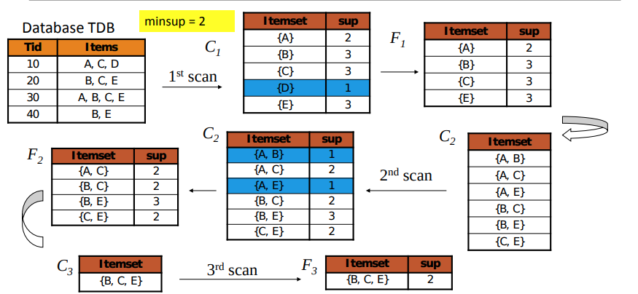
The Apriori Algorithm
Example of Apriori Algorithm
6

Slide 7
The Apriori Algorithm
Strengths of the Apriori Algorithm
Simplicity: The algorithm is straightforward and easy to understand and implement.
Scalability: It can handle large datasets efficiently by utilizing the downward closure property.
Completeness: The Apriori algorithm guarantees to find all frequent itemsets.
7

Slide 8
The Apriori Algorithm
Weaknesses of the Apriori Algorithm
Computational Cost: Generating a large number of candidate itemsets and scanning the dataset multiple times can be computationally expensive.
Memory Usage: The algorithm requires substantial memory to store candidate itemsets and support counts.
Inefficiency with Sparse Data: In datasets with low support thresholds or sparse itemsets, the algorithm may perform inefficiently.
8

Slide 9
The Apriori Algorithm
Optimization Techniques for the Apriori Algorithm
Hash-based Itemset Counting: Utilizing hash functions to reduce the number of passes over the dataset and expedite support counting.
Transaction Reduction: Reducing memory requirements and database size by removing infrequent items or transactions.
Effective Pruning Strategies: Implementing advanced pruning techniques to avoid unnecessary candidate generation and reduce computational overhead.
9

Slide 10
Chapter 3:
Pattern Discovery in Data Mining
Notes:
10

Slide 11
Extension or Improvements of Apriori
Objective
Overview of extension techniques to improve the efficiency of the Apriori algorithm
Techniques like hashing, transaction reduction, and vertical format representation
Benefits and trade-offs of these extensions
11

Slide 12
Extension or Improvements of Apriori
Overview of Extension or Improvements
The Apriori algorithm forms the basis for several extensions and improvements to enhance its efficiency and scalability.
These techniques aim to reduce the computational complexity and memory requirements of the original algorithm.
12

Slide 13
Extension or Improvements of Apriori
Hash-Based and Bitmap Techniques
Hash-Based Itemset Counting:
  Utilizes hash functions to efficiently count the support of candidate itemsets.
  Reduces the number of passes over the dataset and speeds up the counting process.
  Examples include the Hash-Tree and the Trie-based methods.
Bitmap Techniques:
  Represent the presence or absence of items in transactions using bitmaps.
  Enable faster itemset support counting and reduce memory usage.
  Examples include the FP-Tree and the Eclat algorithm.
13

Slide 14
Extension or Improvements of Apriori
Transaction Reduction and Sampling
Transaction Reduction:
  Removes infrequent items or transactions from the dataset.
  Reduces the memory requirements and database size, improving the algorithm's efficiency.
  Techniques like Transaction Reduction with Gap Elimination (TRG) and Transaction ID List Intersection (TID-intersection) are commonly used.
Sampling:
  Selects a representative subset of the original dataset for mining.
  Enables faster processing by operating on a smaller dataset.
  Techniques include Random Sampling and Stratified Sampling.
14

Slide 15
Extension or Improvements of Apriori
Dynamic Itemset Counting and Pruning
Dynamic Itemset Counting:
  Adapts the support counting process dynamically during the mining process.
  Avoids redundant scanning of the entire dataset for each iteration.
  Examples include the Dynamic Counting Principle and Dynamic Hashing.
Dynamic Pruning:
  Prunes infrequent itemsets and reduces unnecessary candidate generation.
  Improves efficiency by eliminating unpromising itemsets early.
  Techniques like Dynamic Itemset Counting Pruning (DICP) and Dynamic Rule Pruning (DRP) are used.
15

Slide 16
Extension or Improvements of Apriori
Hybrid Approaches
Combine the strengths of multiple algorithms to improve performance.
Examples include the Apriori-Hybrid algorithm, which combines the Apriori algorithm with other techniques like FP-Growth or vertical format.
16

Slide 17
Extension or Improvements of Apriori
Benefits and Trade-offs
Benefits of the extensions and improvements:
  Reduced computational complexity and improved efficiency.
  Lower memory requirements and better scalability.
  Faster mining on large-scale datasets.
Trade-offs to consider:
  Increased implementation complexity.
  Algorithm-specific parameters and tuning requirements.
  Potential trade-offs between memory usage, runtime, and the accuracy of results.
17

Slide 18
Summary
The Apriori Algorithm
Apriori: Mines frequent itemsets.
Steps: Generate candidates, prune, repeat.
Strengths: Simplicity, effective.
Weaknesses: Inefficient for large datasets.
18

